Slide 1
Species List – Table 4; Kvitek 1987
Brachiopods GW
Terebratalia transversa r
Bryozoans GW
Aglaoephenia spp. p
Cnidarians - KF
Anthozoans
Anthopleura elegantissima p
Anthopleura xanthogrammica c
Balanophyllia elegans c
Corynactis californica r
Epiactus proliferata p
Gersemia rubiformis p
Metridium senile r
Urticina crassicornis p
Urticina lofotensis r
r=rare (<1/dive), p=present (1-5/dive), c=common (5-50/dive), a=abundant (50-100/dive), va=>100/dive
Scyphozoans - GW
Thaumatoscyphus hexaradiatus p
Crustaceans - GW
Decapoda
Cancer oregonensis c
Cryptolithodes sp. r
Scyra acutifrons p-c
Mimulus foliatus r
Pagurus sp. c
Pandalus sp. r
Other
Balanus sp. p
Amphithoe sp. r
Idotea resecata r

Slide 2
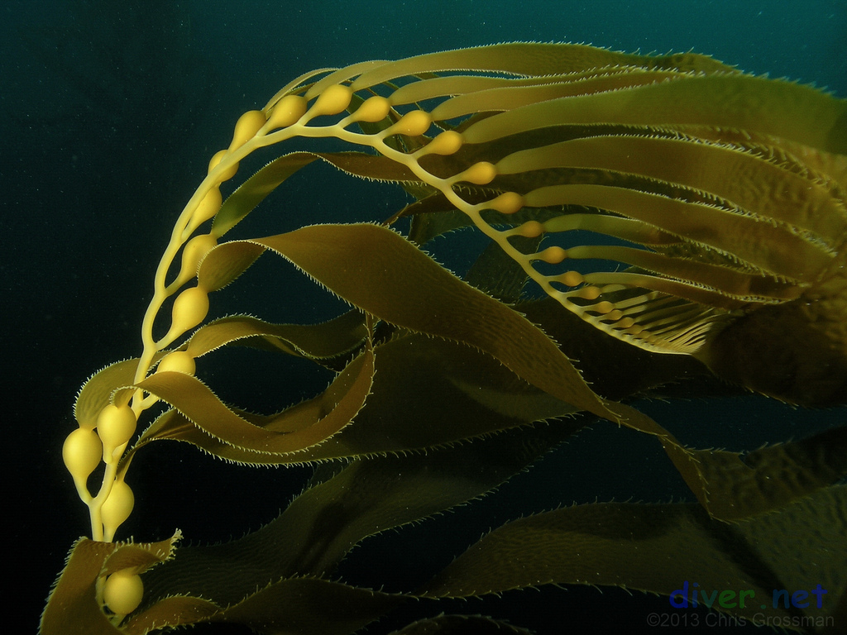
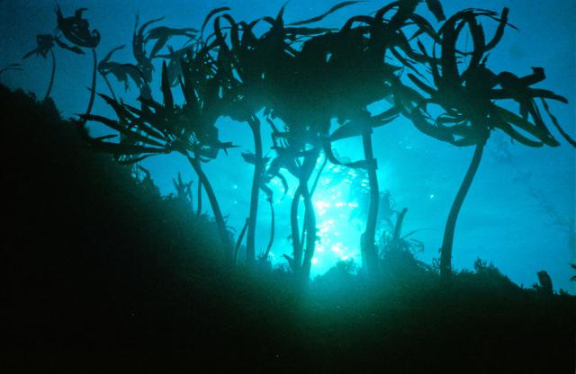
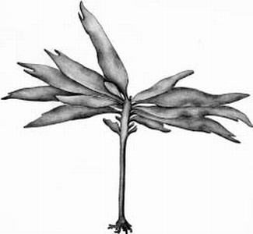
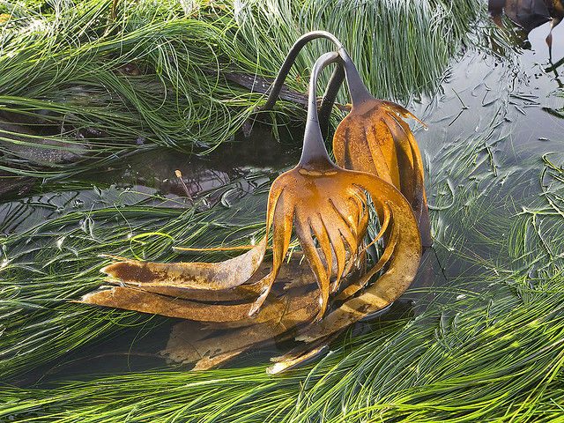
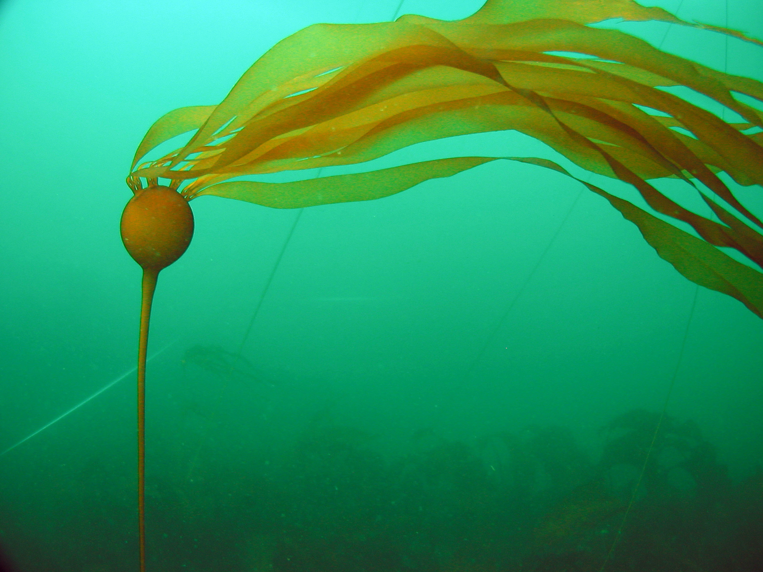
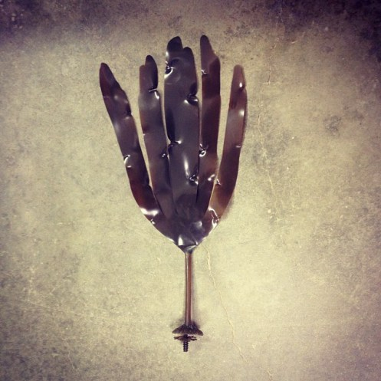
Brown Algae
Macrocystis pyrifera
Pterygophora californica
Laminaria setchellii (looks like Laminaria dentigera)
Nereocystis luetkeana

Slide 3
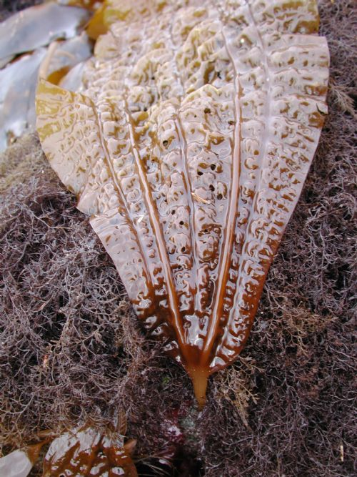
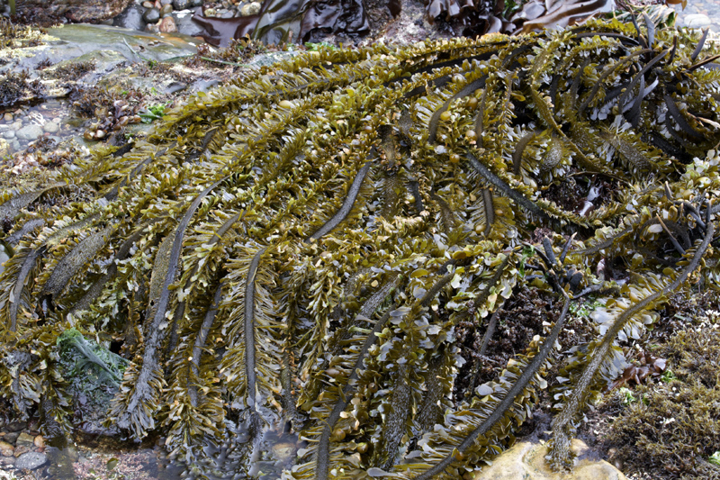
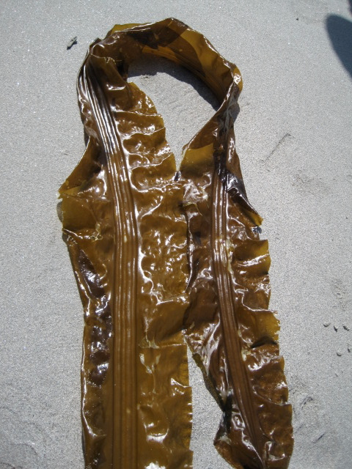
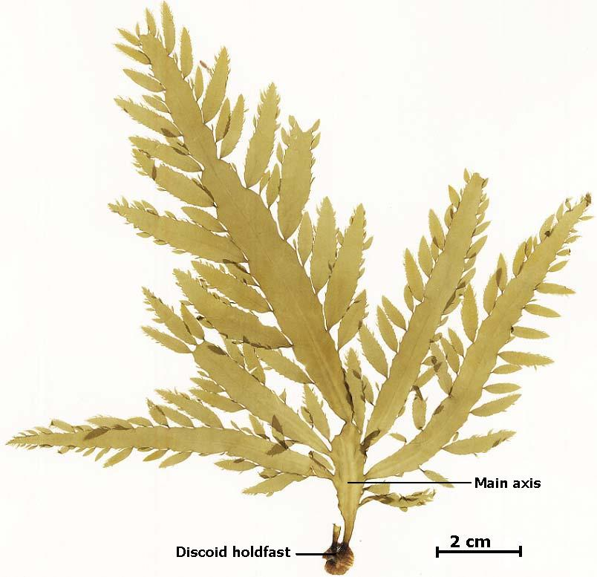
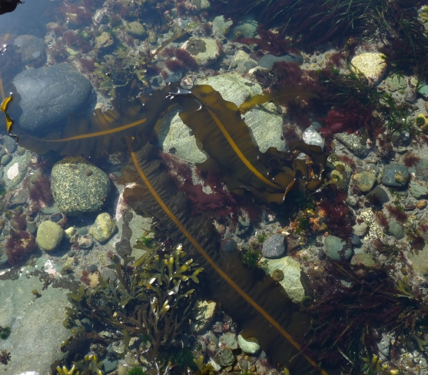
Brown Algae
Costaria costata (5 rib)
Egregia menziesii
Cymathere triplicata
Desmerestia ligulata
Alaria marginata

Slide 4
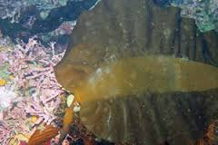
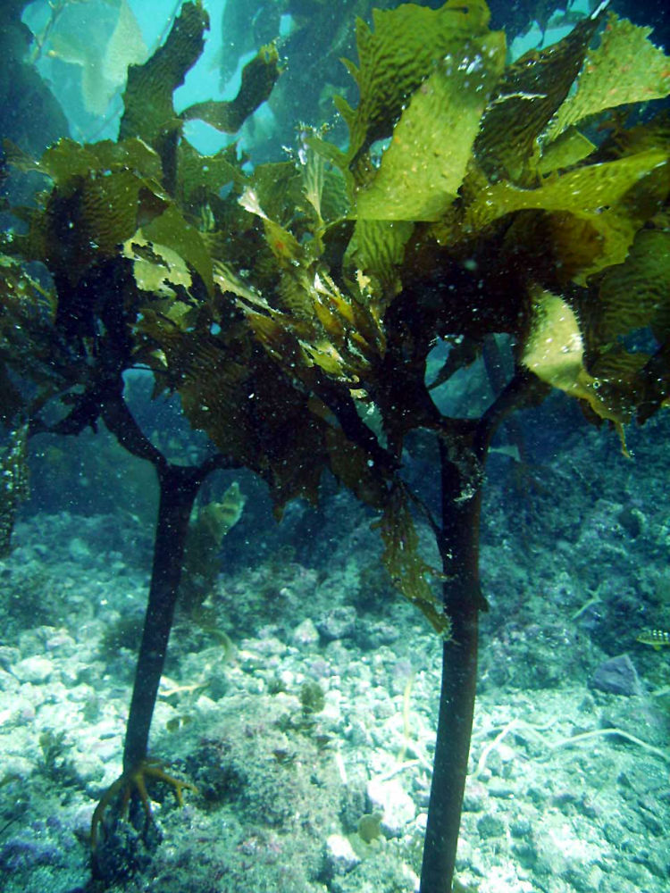
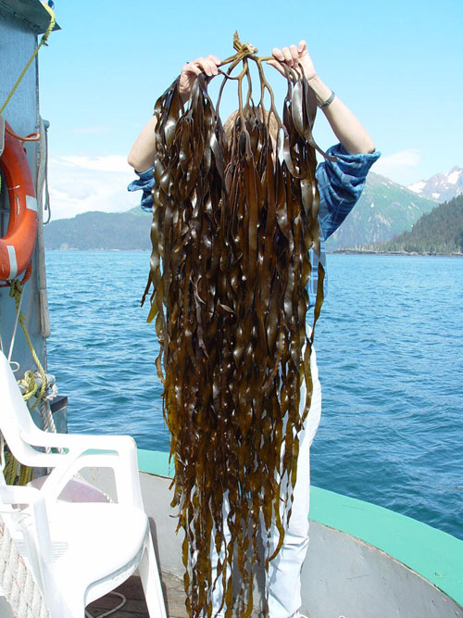
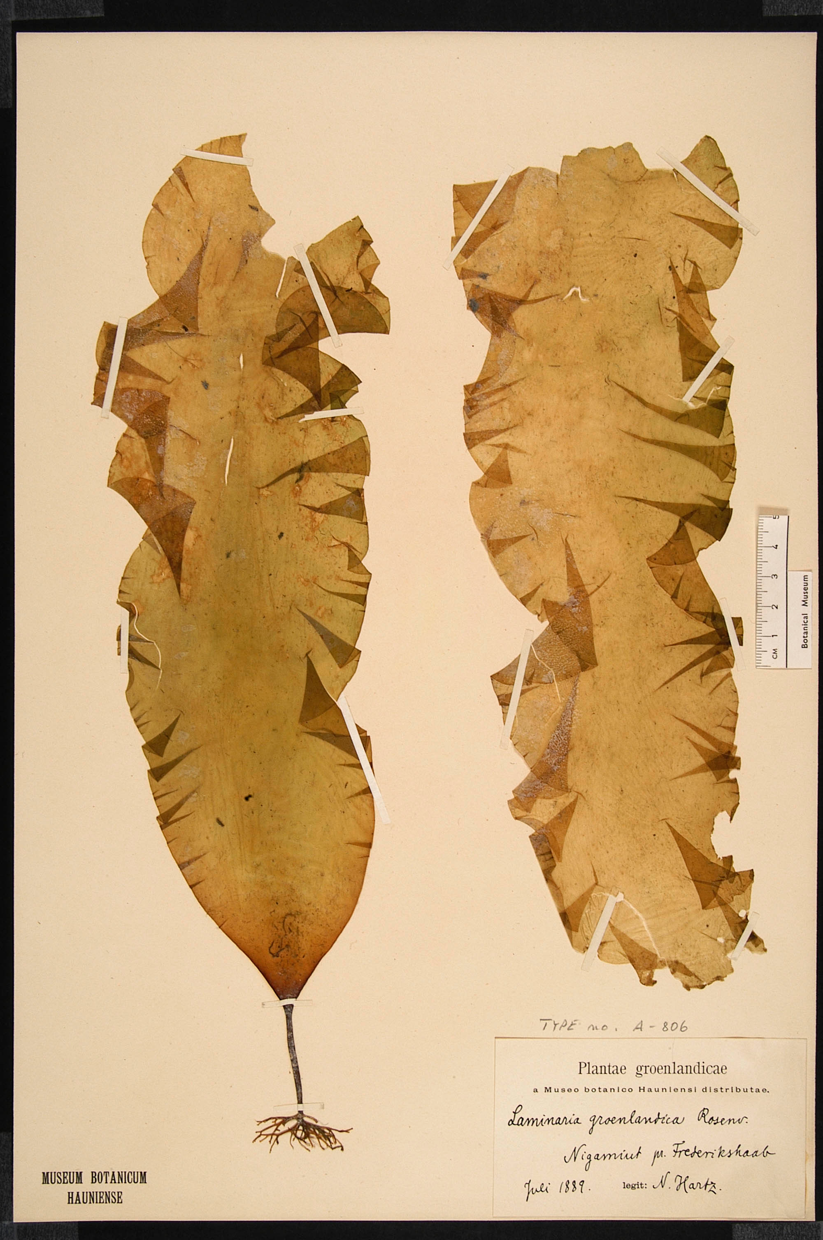
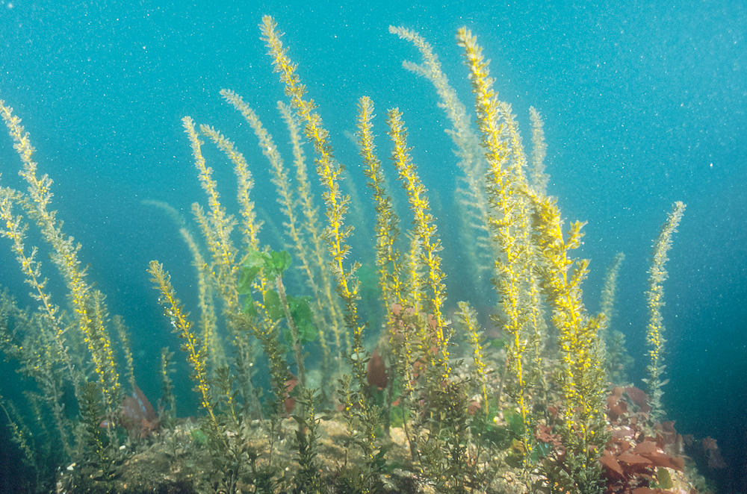
Brown Algae
Pleurophycus gardeneri
Eisenia arborea
Lessoniopsis littoralis
Laminaria groenlandica
Sargassum muticum

Slide 5
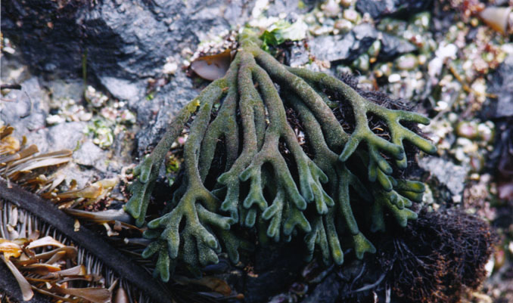
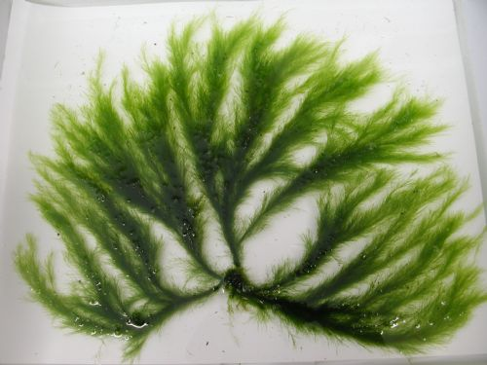
Green Algae
Codium fragile
(Codium sp. also comes in pin-cushion form)
Acrosiphonia coalita

Slide 6
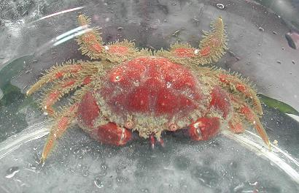
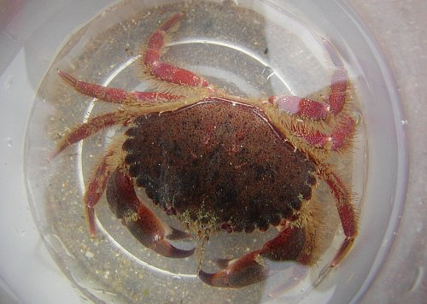
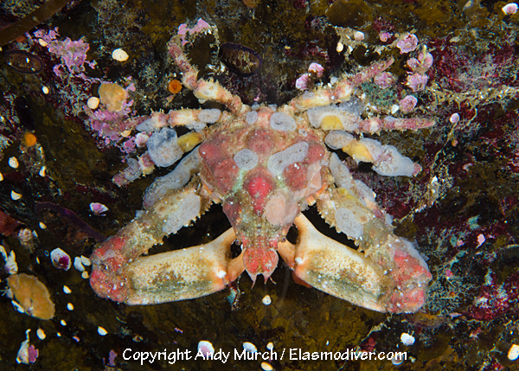
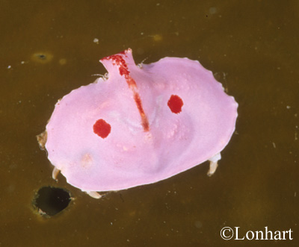
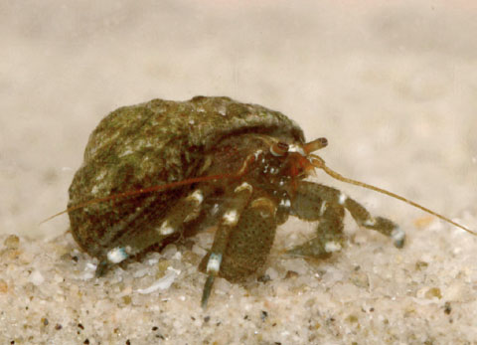
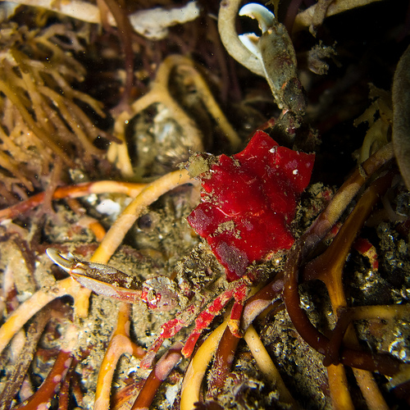
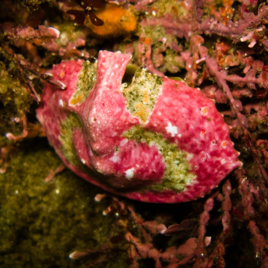
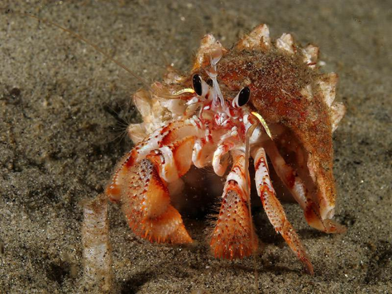
Decapod Crustacea (Crabs)
Scyra acutifrans
Cancer oregonensis
Cryptolithodes sitchensis
Pagurus hirsutiusculus
P. armatus
Mimulus foliatus

Slide 7
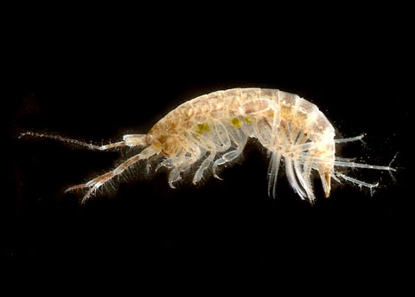
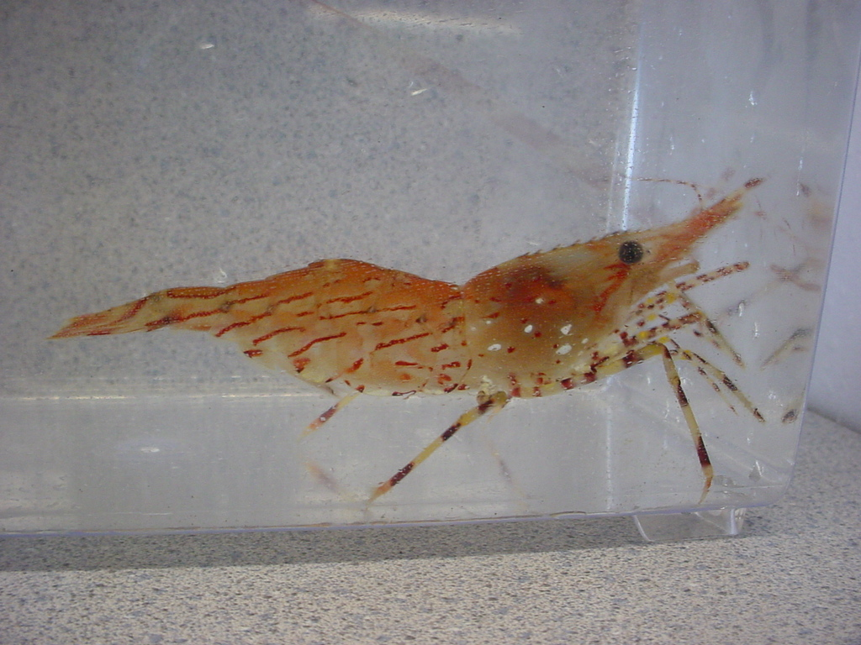
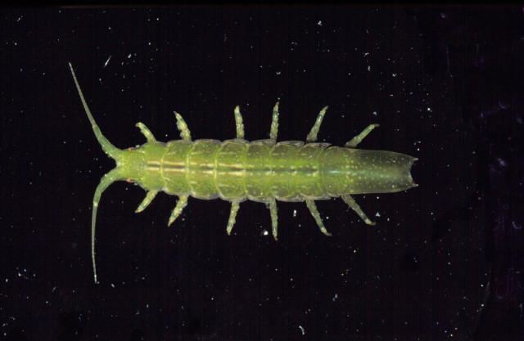
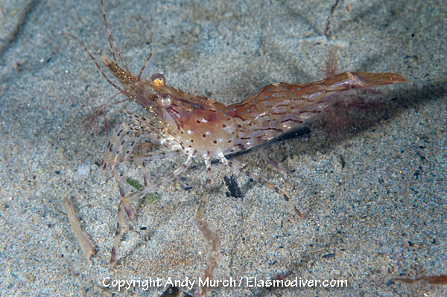
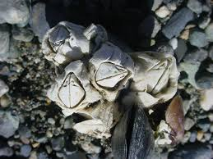
Other Crustaceans
Pandalus danae
Amphipod:
Amphithoe plumulosa
Isopod: Idotea resecata
Barnacle: Balanus sp.

Slide 8
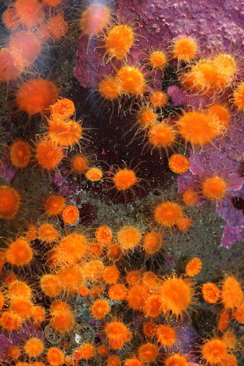
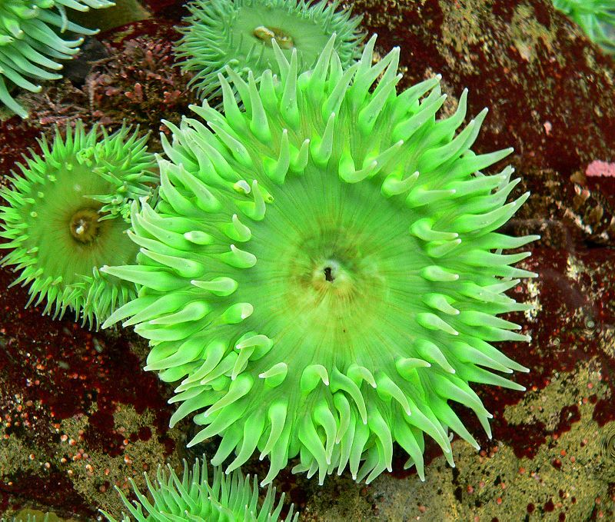
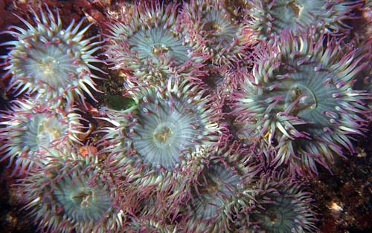
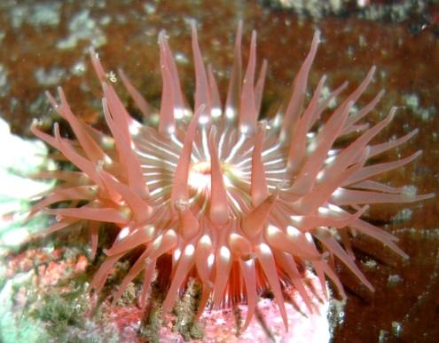
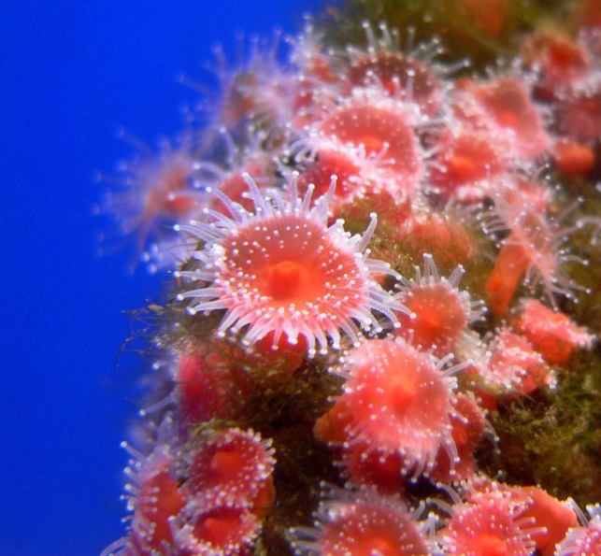
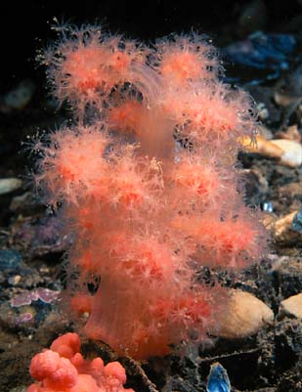
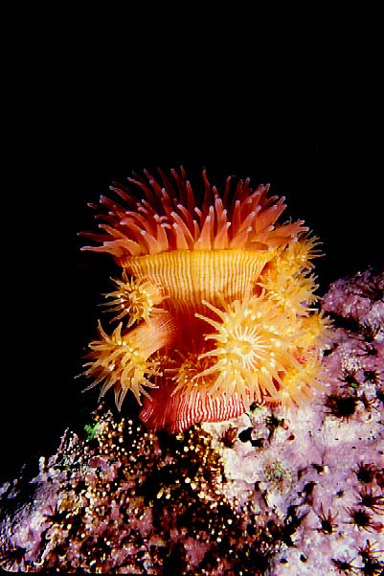
Cnidarians
Balanophyllia elegans (orange cup coral)
Anthopleura elegantissima (aggregating anemone)
Anthopleura xanthogrammica (giant green anemone)
Epiactis prolifera (brooding anemone)
Corynactis californica (strawberry anemone)
Gersemia rubiformis
(sea strawberry, soft coral)

Slide 9
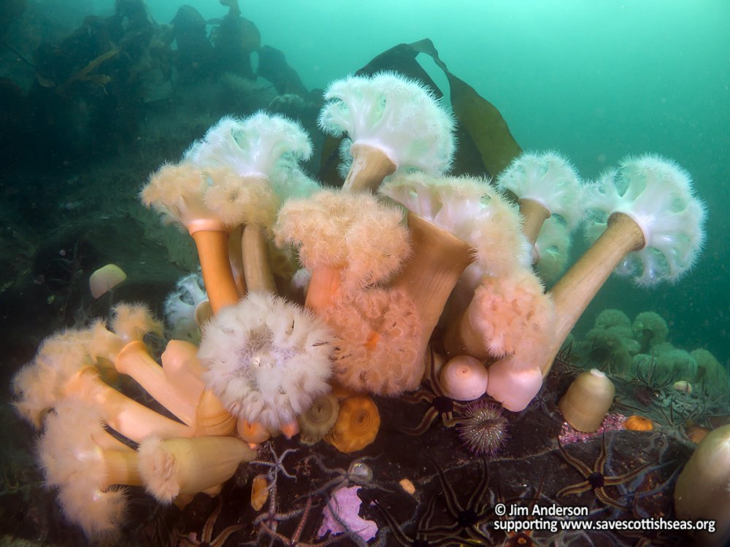
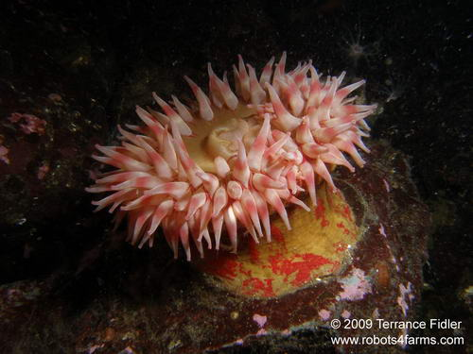
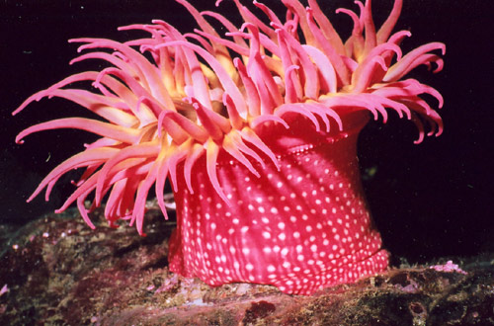
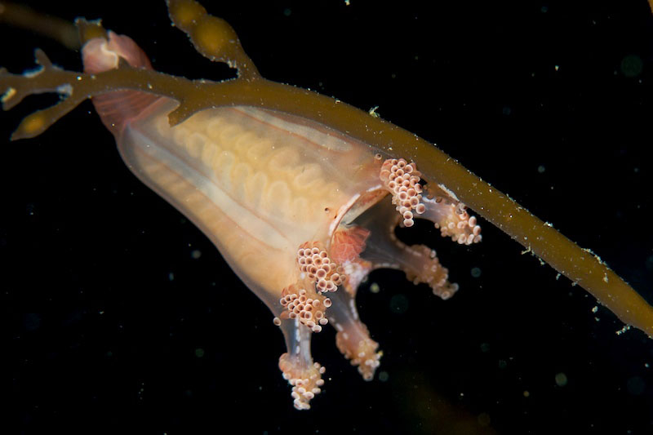
Cnidarians
Metridium senile (plumose anemone)
Urticina crassicornis (mottled anemone)
Scyphozoans
Manania hexaradiata
(stauromedusan, stalked jelly)
Urticina lofotensis
(white-spotted rose anemone)

Slide 10
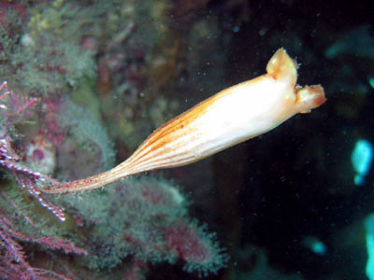
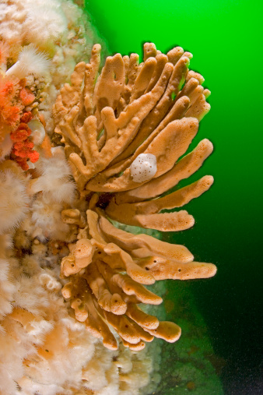
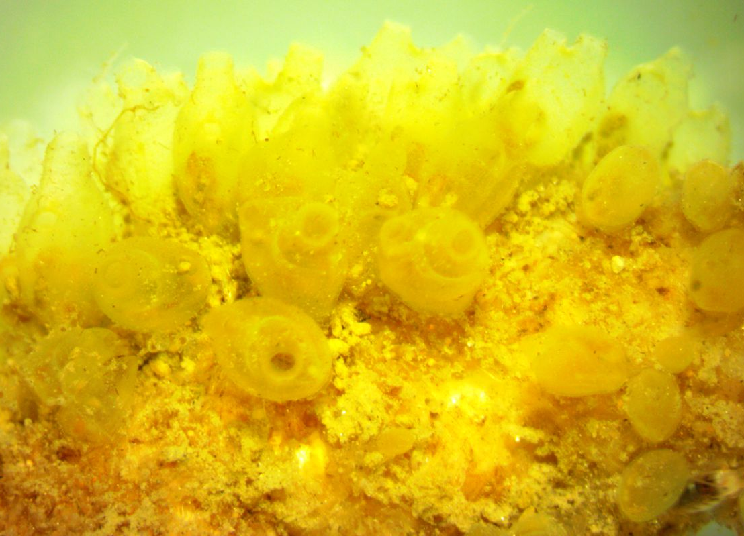
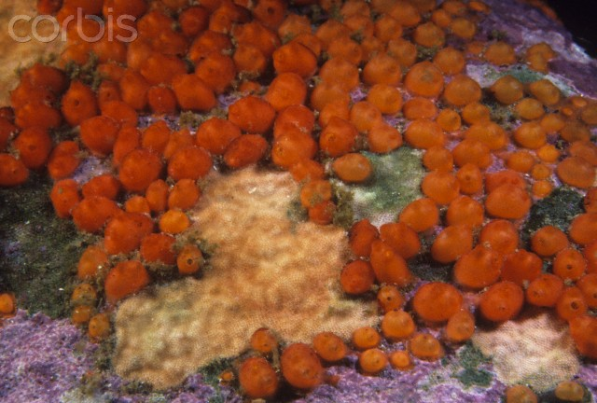
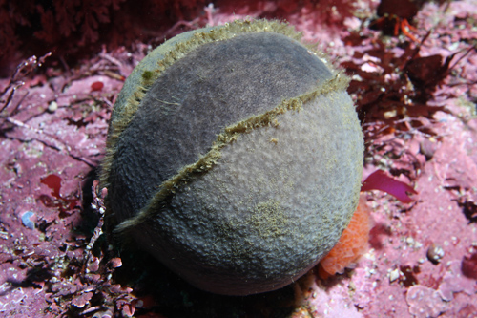
Tunicates
Sponges
Styela montereyensis
(Monterey stalked tunicate)
Isodictya quatsinoensis
(orange finger sponge)
Perophora annectens
(sea grapes, yellow social tunicate)
Metandrocarpa taylori
(Taylor’s social tunicate)
Craniella arb
(grey puffball sponge)

Slide 11
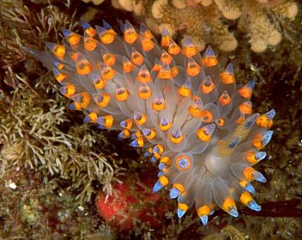
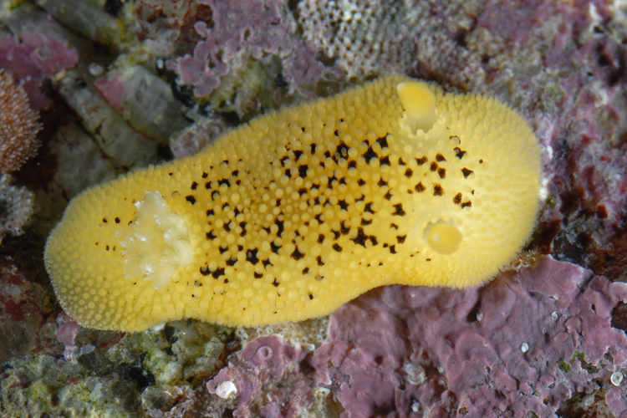
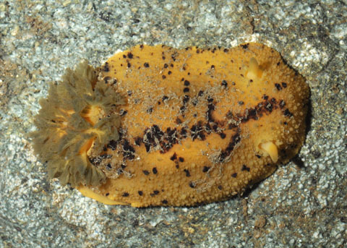

Nudibranchs
Montereina nobilis
(Pacific sea lemon, spots between but not on tubercules)
Janolus barbarensis
Doris montereyensis
(Monterey sea lemon, spots on tubercules, gills darker than body)
Doris odhneri
(white knight dorid, low tubercules)

Slide 12




Nudibranchs
Dirona albolineata
(white-lined dirona)
Tritonia festiva
(diamond back tritonia)
Triophe catalinae
(sea clown triophe)
Limacia cockerelli
(orange-clubbed nudibranch)

Slide 13




Sea Cucumbers
Eupentacta quinquesemita
(stiff-footed cucumber)
Cucumaria miniata
(orange sea cucumber)
Parastichopus californicus
(giant sea cucumber)

Slide 14




Urchins
Mesocentrotus franciscanus
(red sea urchin)
Mesocentrotus purpuratus
(purple sea urchin)
Mesocentrotus droebachiensis
(green sea urchin)

Slide 15


Hydrozoans
Ectopleura crocea
(pink-mouth hydroid)
Stylantheca papillosa

Slide 16







Echinoderms
Evasterias troschelii
(mottled star)
Dermasterias imbricata
(leather star)
Henricia leviuscula
(blood star)
Leptasterias hexactis
(six-rayed star)
Pisaster ochraceus
(ochre star)

Slide 17





Echinoderms
Orthasterias koehleri
(red-banded or rainbow star)
Patiria miniata
(bat star)
Solaster dawsoni
(morning sun star)
Pycnopodia helianthoides
(sun star)
Solaster stimpsoni
(striped sun star)

Slide 18




Bryozoans
Ostrich plume hydroid:
Aglaophenia sp.
Brachiopods
Lampshell:
Terebratalia transversa
Ophiuroid
Brittle star:
Ophiura sarsi
Scyphozoa
Thaumatoscyphus (=Manania)

Slide 19


Bivalvia
Rock scallop: Crassodoma gigantea
Nemertea
Nemertean worm

Slide 20




Polychaeta (http://seanet.stanford.edu/Polychaeta/)
Featherduster worm:Eudistylia polymorpha
Myxicola infundibulum
Phragmatopoma californica
Dodecaceria fewkesi

Slide 21






Fishes
Chirolophis nugator
(mosshead warbonnet)
Gibbonsia spp.
(kelpfish)
Rhacochilus vacca
(pile perch)
Embiotoca lateralis
(striped surfperch)
Rhinogobiops nicholsii
(black-eyed goby)
Gobiesox maeandricus
(Northern clingfish)

Slide 22





Sculpins
Artedius harringtoni
(scalyhead sculpin)
Jordania zonope
(longfin sculpin)
Asemichthys taylori
(spinynose sculpin)
Hemilepidotus hemilepidotus
(red Irish lord)
Scorpaenichthys marmoratus
(cabezon)

Slide 23





Greenlings
Ophiodon elongatus
(lingcod)
Hexagrammos decagrammus
(kelp greenling - male)
(female)
Oxylebius pictus
(painted greenling)
Hexagrammos stelleri
(whitespotted greenling)

Slide 24







Rockfishes
Sebastes auriculatus
(brown)
Sebastes melanops
(black)
Sebastes flavidus
(yellowtail)
Sebastes caurinus
(copper)
Sebastes melanops
(blue)
Sebastes nebulosus
(china)
Sebastes emphaeus
(Puget Sound)

Slide 25
Species List – Table 4; Kvitek 1987
Echinoderms KF
Dermasterias imbricata p
Evasterias troschelii c
Henricia leviuscula c
Leptasterias hexactis c
Orthasterias koehleri r
Patiria miniata r
Pisaster ochraceas p
Pycnopodia helianthoides p
Solaster dawsoni r
Solaster stimpsoni p
Urchins KF
Strongylocentrotus drobachiensis
Strongylocentrotus franciscanus
Strongylocentrotus purpuratus
Sea Cucumbers - KF
Cucumaria miniata
Eupentacta quinquesemila
Stichopus californicus
Ophiuroids GW
Hydrozoans KF
Allepora porphyra
Tubularia crocea

Slide 26
Species List – Table 4; Kvitek 1987
Gastropods
Amphissa columbiana p
Calliostoma ligatum c
Ceratostoma foliatum c
Crepidula adunca p
Ocenebra lurida p
Opalia chacei p
Searlesia dira r
Tegula brunnea p
Chitons
Cryptochiton stelleri p
Mopalia lignosa p-c
Placiphorella velata p
Tonicella lineata p
Limpets
Acmaea mitra c
Colisella instabilis c
Diodora aspera c
Nudibranchs - KF
Anisodoris nobilis p
Antiopella barbarensis p
Archidoris montereyensis c
Archidoris odhneri p
Dirona albolineata p
Laila cockerelli p
Triophe catalinae c
Tritonia festiva p

Slide 27
Species List – Table 4; Kvitek 1987
Bivalves - GW
Hinnites giganteus p
(Crassodoma gigantea)
Nemerteans spp. - GW p
Polychaetes - GW
Dodecaceria fewkesi p
Eudistylia spp. p
Myxicola infundibulum p
Phragmatopoma californica p
Sponges - KF
Tetilla arb p
Isodictya quatsinoensis p
Tunicates - KF
Styela montereyensis a
Perophora annectens p
Metanfrocarpa taylori p
Fishes - GW
Damalichthys vacca r
Embiotica lateralis p
Gibbonsia spp. r
Gobieosox spp. r
Hexagrammos decagrammus c
Ophiodon elongatus p
Oxylebius pictus r
Scorpaenichthys marmoratus p
Sebastes auriculatus r
S. caurinus r
S. melanops c
S. nebulosus p

Slide 28












Epialtidae
Cancridae
Paguridae
Trochidae
Idoteidae
Caprellidae
Gammaridae
Littorinidae
Rissoidae
Columbellidae
Haminoeidae
Hippolytidae
Crangonidae
Pandalidae
Notes:
Introduce these 14 major families
Make special note of Economic and Ecological importance

